Slide 1
Managing Data with Microsoft 365

Slide 2

Managing and automating data

Slide 3

Christine Matheney
Senior Program Manager

Slide 4



In this course:
Forms
Power Automate
Excel
Power BI

Slide 5
Managing Data with Microsoft 365

Slide 6
The Value of Forms

Slide 7
In this lesson:
Collecting data with forms

Slide 8

Data Source
Forms
Surveys
Quizzes

Slide 9
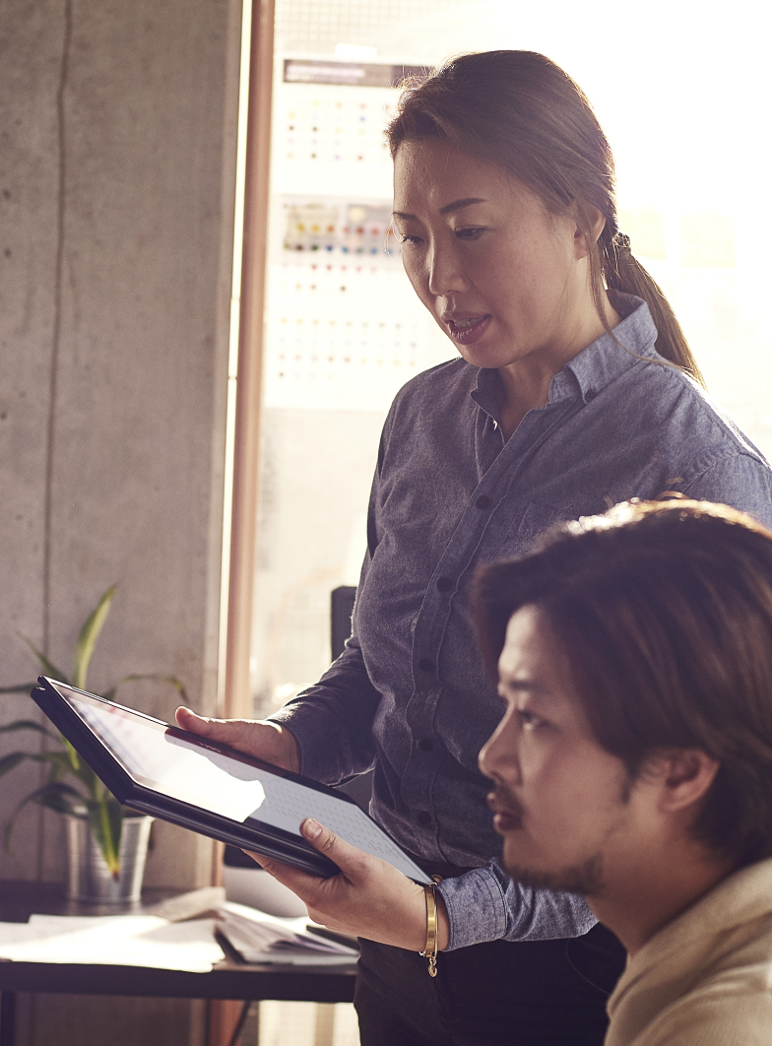
Understand the value of Forms
Create a form
Gather information
Access data
Improve your work

Slide 10
Navigating Microsoft Forms

Slide 11
In this lesson:
Exploring Microsoft Forms

Slide 12
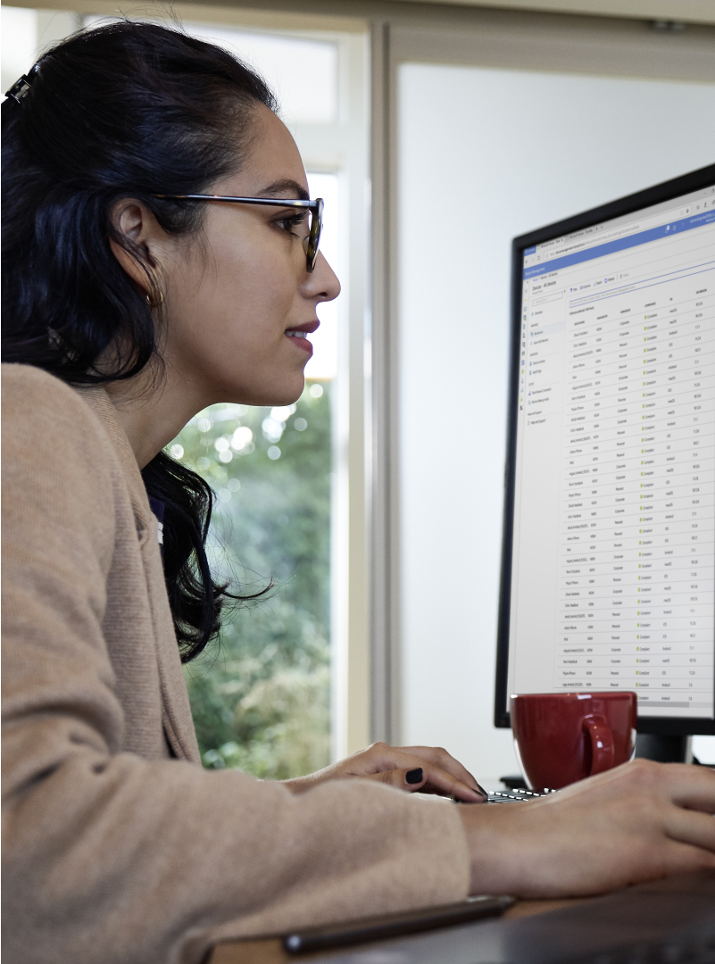
Create your first form
Navigate to the Forms app
Create a form
Add your content

Slide 13
Creating Your First Form

Slide 14
In this lesson:
Collecting information with Microsoft Forms

Slide 15

Explore Microsoft Forms
Create a form
Add new questions

Slide 16
Customizing Your Forms

Slide 17
In this lesson:
Customizing Surveys

Slide 18
Customize your survey
Set the required fields
Organize into sections
Add branching
Test the survey

Slide 19

Customize your survey
Set the required questions
Add branching
Gather test data

Slide 20
Gathering Survey Data

Slide 21
In this lesson:
Sharing surveys

Slide 22
Sharing a Form
Link
QR code
Embed
Email

Slide 23

Gather Survey Responses
Finalize a survey
Share a link
Review responses

Slide 24
Collaborating on Forms

Slide 25
In this lesson:
Sharing Forms with collaborators

Slide 26
Best Options for:
Team
Entire Organization

Slide 27

Collaborate with Forms
Create a Form
Share it with others
Send it out for review

Slide 28
Why Use Power Automate?

Slide 29
In this lesson:
Exploring the benefits of Power Automate

Slide 30
Power Automate
Save time
Remove repetitive tasks

Slide 31
Power Automate Features
Templates
Inbox actions
Collaboration

Slide 32
Power Automate Versions
Desktop
Web
Mobile

Slide 33
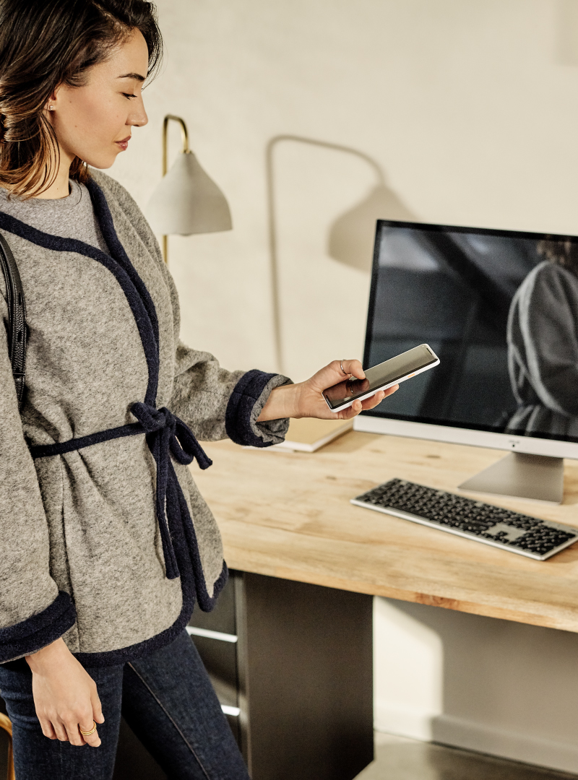
Try Out Power Automate
Test out templates
Keep your inbox organized
Stay on top of projects

Slide 34
Navigating Power Automate

Slide 35
In this lesson:
Creating flows in Power Automate

Slide 36
FLOWS
When This Happens
TRIGGERS
Do That
ACTIONS

Slide 37
Connectors
Enable Power Automate to work with different apps
Contains triggers and actions
Can be set up as conditional “if/then” statements

Slide 38
FLOWS
When This Happens
TRIGGERS
Do That
ACTIONS

Slide 39

Explore Power Automate
Review flow templates
Find what works best

Slide 40
Creating Your First Power Automate

Slide 41
In this lesson:
Creating automated email replies

Slide 42

Create a Flow
Identity a need
Build your flow
Test your flow

Slide 43
Integrating with Other Products

Slide 44
In this lesson:
Using templates in Power Automate

Slide 45

Create a Flow from a Template
Explore flow templates
Find what works best
Customize your template

Slide 46
Managing Data in Excel

Slide 47
In this lesson:
Sorting and filtering data

Slide 48
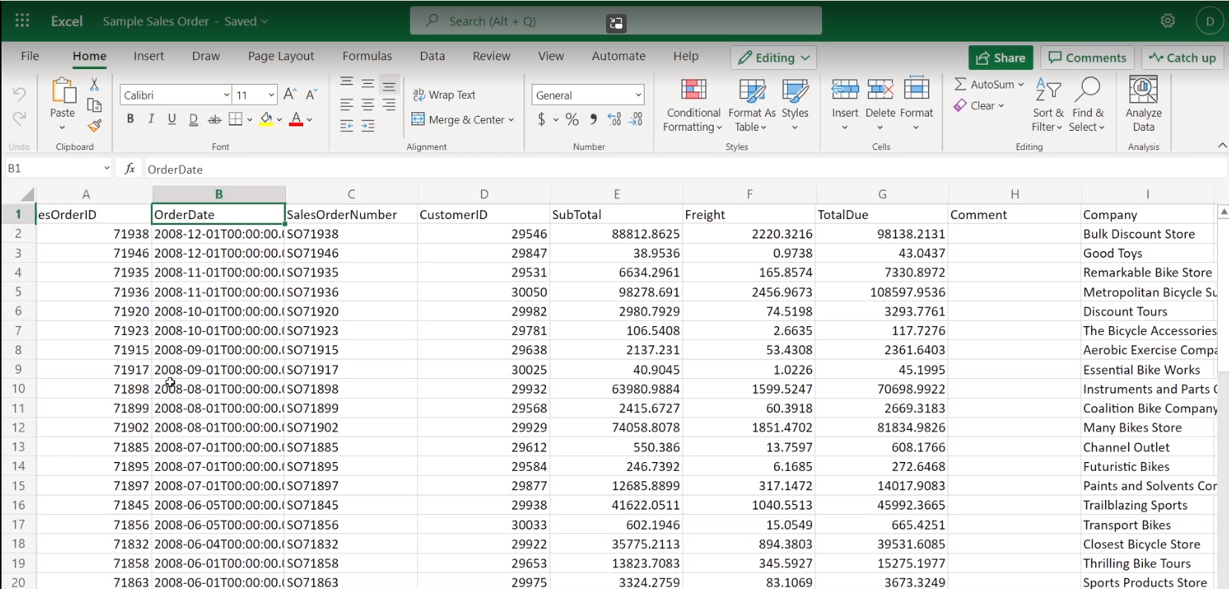
Exercise Files > Sample Sales Order.xlsx

Slide 49
Excel Features
Search for specific data
Filter data
Sort using multiple columns in a table

Slide 50

Find Your Data
Sort to reorder values
Filter out data

Slide 51
Using PivotTables

Slide 52
In this lesson:
Simplify and present data using PivotTables

Slide 53
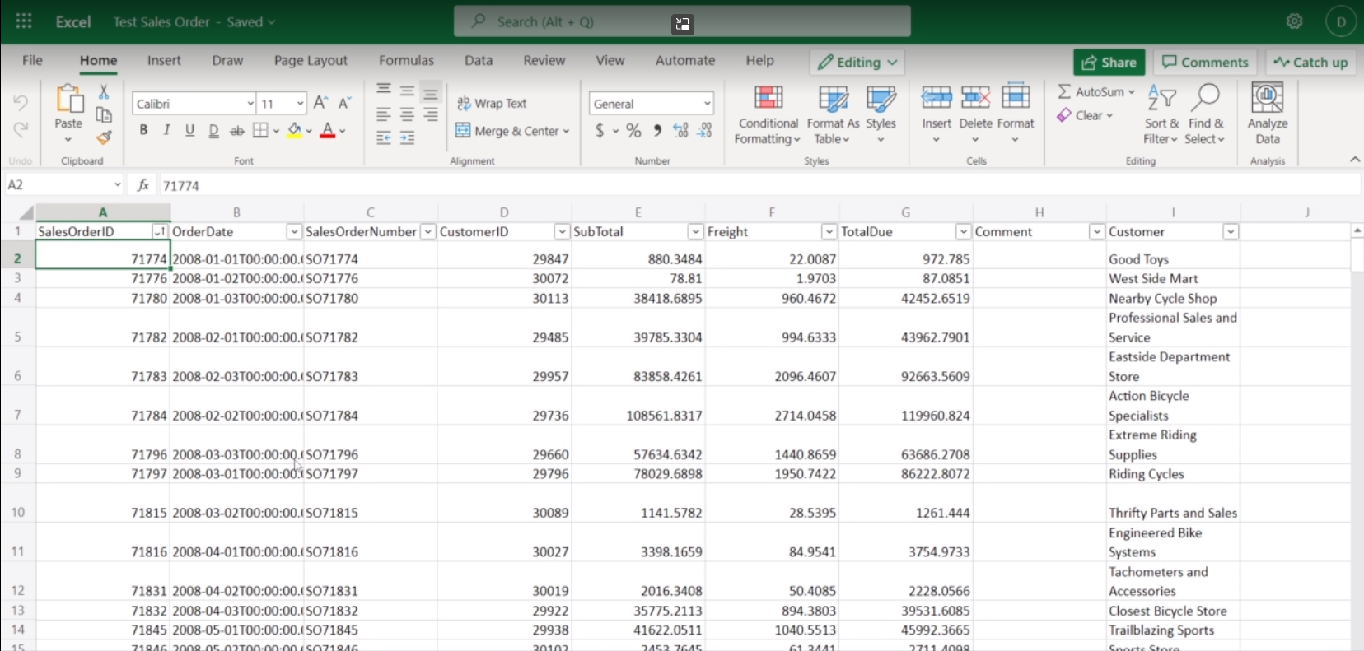
Exercise Files > Test Sales Order.xlsx

Slide 54

Explore PivotTables
Choose a worksheet
Select cells
Insert PivotTable

Slide 55
Creating your First PivotTables

Slide 56
In this lesson:
Building PivotTables

Slide 57
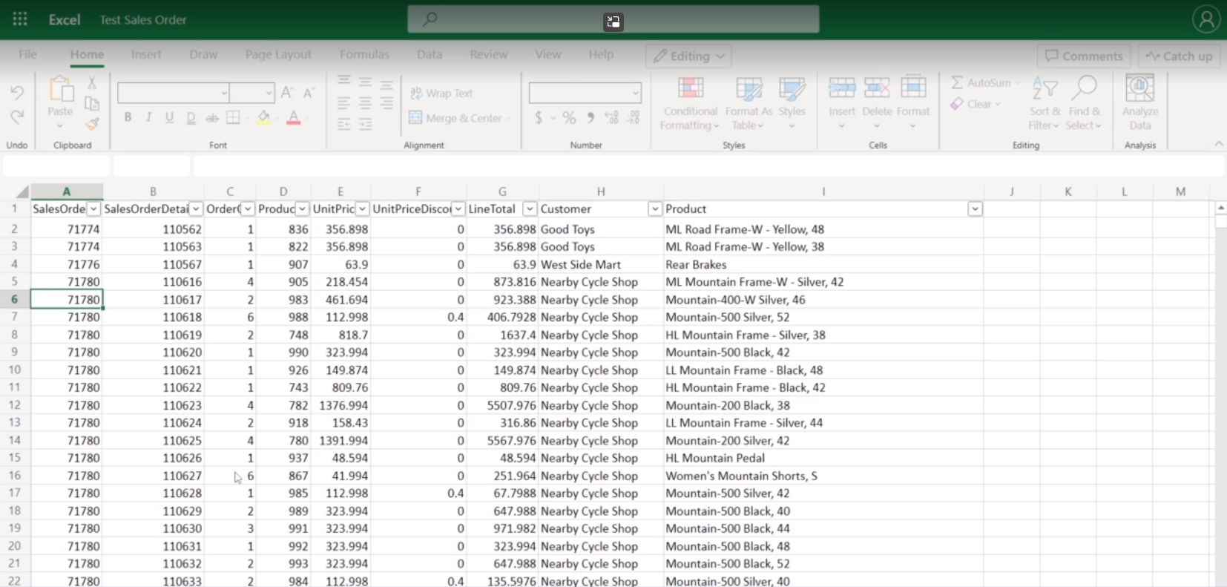
Exercise Files > Test Sales Order.xlsx

Slide 58

Explore Pivot Tables
Choose a worksheet
Select cells
Insert PivotTable
Analyze worksheet data

Slide 59
Using XLOOKUP

Slide 60

In this lesson:
Combining data sources using XLOOKUP

Slide 61
XLOOKUP Document Requirements
Two Excel tables
At least one matching column

Slide 62
XLOOKUP Function Requirements
Lookup_value – the value to look up
Lookup_array – the column to search for lookup value
Return_array – the column of data to return

Slide 63
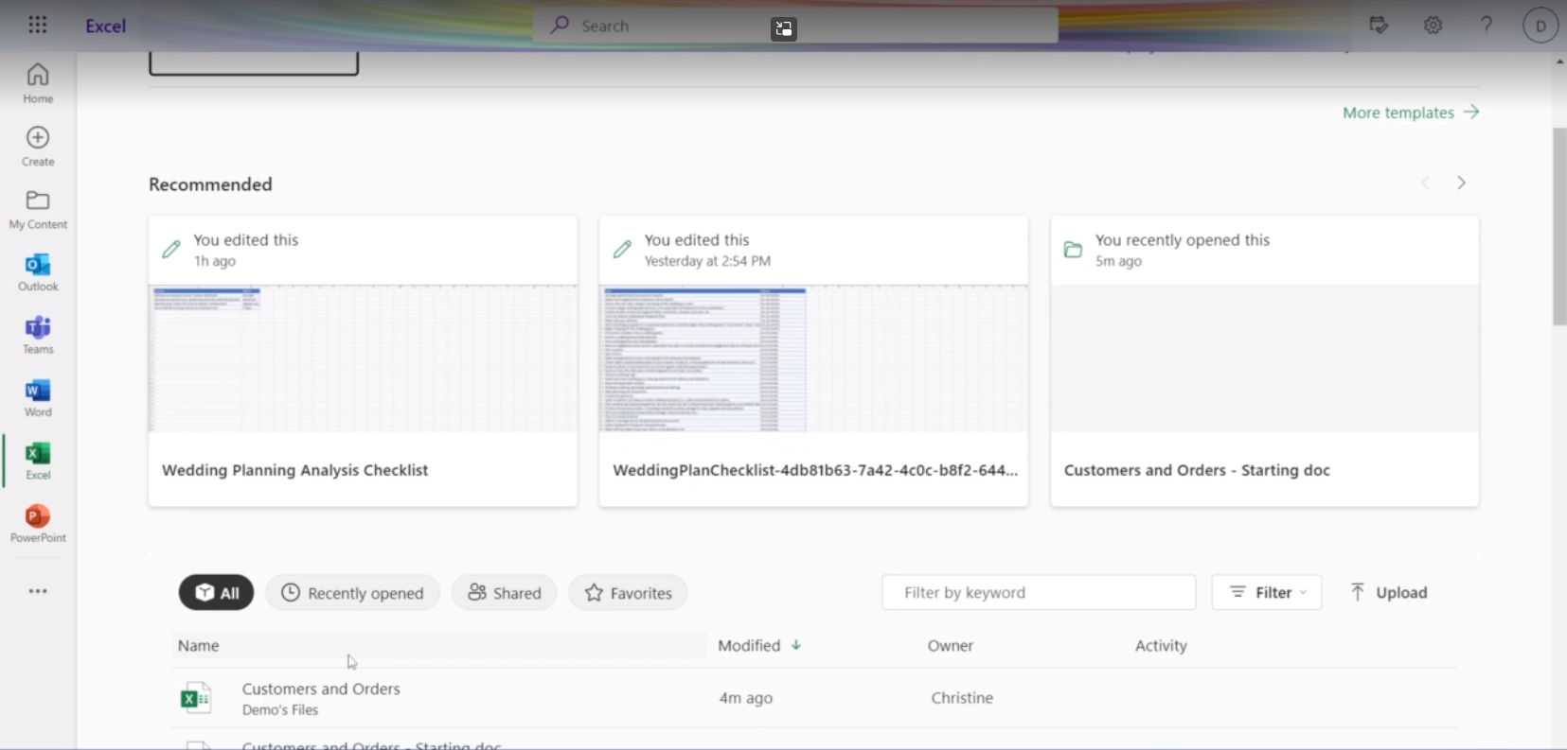
Exercise Files > Customer and Order.xlsx

Slide 64

Try Out XLOOKUP
Explore data sources
Combine data

Slide 65
Why use Power BI?

Slide 66
In this lesson:
Understanding Power BI

Slide 67
Power BI
Provides a visual framework
Models information
Creates interactive reports
Helps provide insights

Slide 68
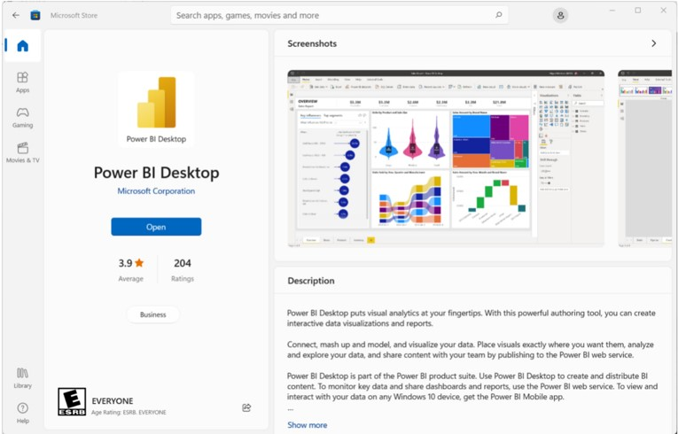
Pro Tip
Power BI Desktop is free on the Microsoft store.

Slide 69


Microsoft 365 Connections
Power BI
One Drive
Share Point

Slide 70

Try Out Power BI
Create data visualizations
Inform your audience
Use it for free

Slide 71
Navigating Power BI

Slide 72
In this lesson:
Navigating Power BI on desktop

Slide 73
Common Power BI Functions
New Visual: Adds a visualization
Excel Workbook: Imports data into the program
Transform Data: Prepares data for use

Slide 74
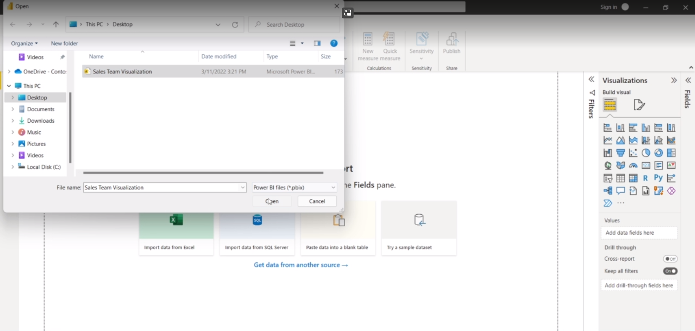
Exercise Files > Sales Team Visualization pbix

Slide 75
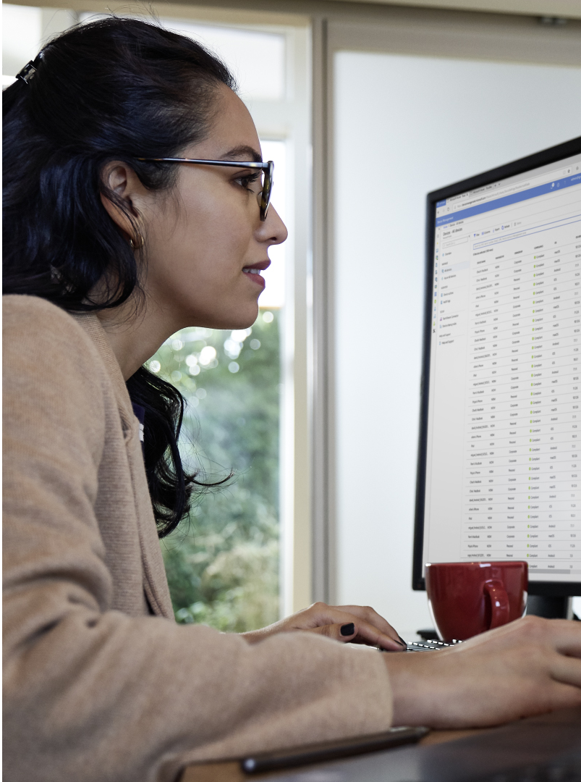
Navigate Through Power BI
Install Power BI
Open the desktop app
Explore different visualization

Slide 76
Importing Data in Power BI

Slide 77
In this lesson:
Importing data

Slide 78
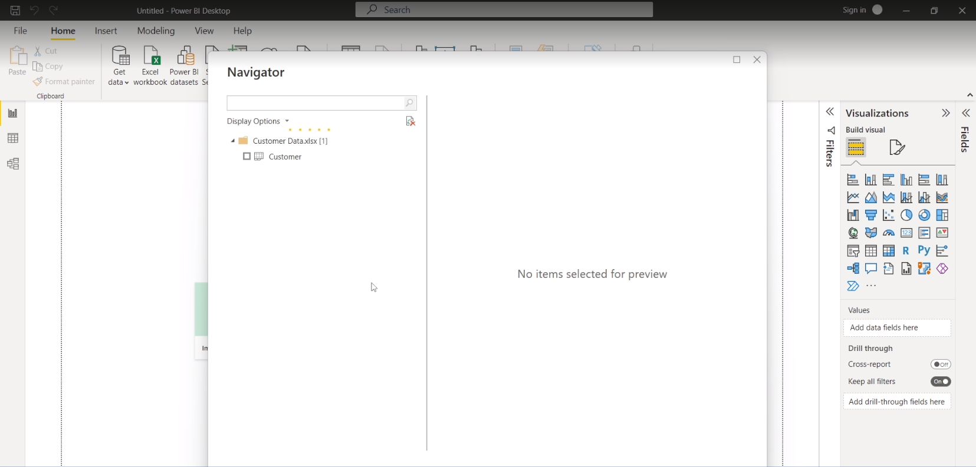
Exercise Files > Customer Data.xlsx

Slide 79

Import your data
Create a new report
Import external data
Clean the data

Slide 80
Managing your Power BI Data

Slide 81
In this lesson:
Intelligent importing in Power BI

Slide 82
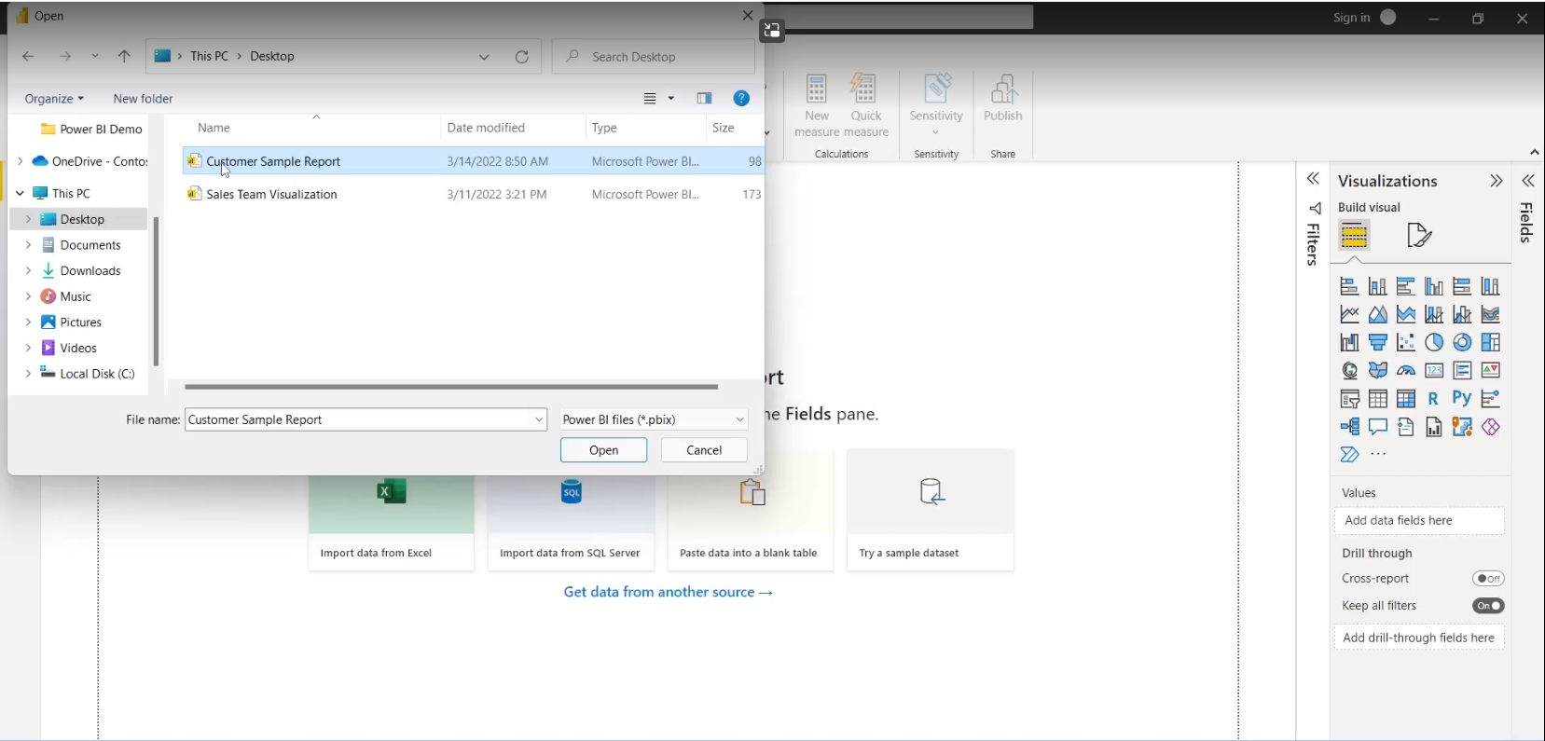
Exercise Files > Customer Sample Report.pbix

Slide 83
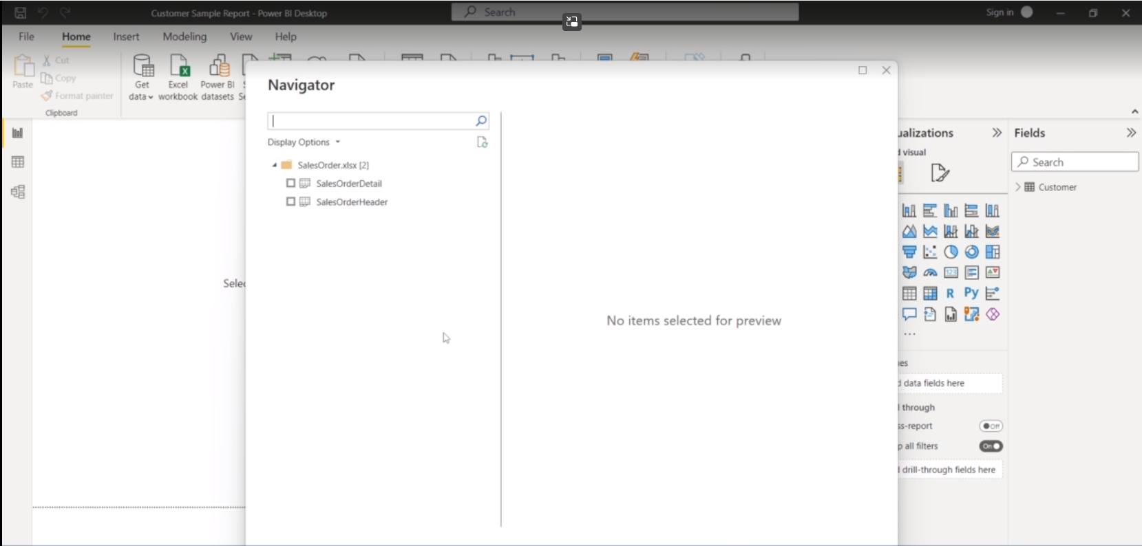
Exercise Files > SalesOrder.xlsx

Slide 84

Manage Your Power BI Data
Import data from multiple sources
Create relationships

Slide 85
Creating Power BI Reports

Slide 86
In this lesson:
Building reports using Power BI

Slide 87
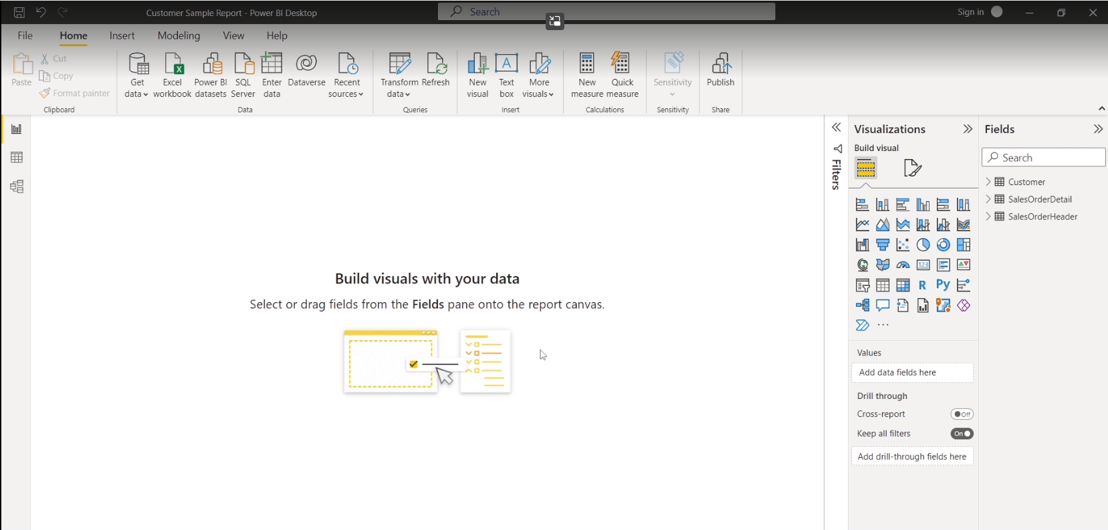
Exercise Files > SalesOrder.xlsx and Customer Data.xlsx

Slide 88

Create your first report
Import your data
Identify points to visually represent
Create a visualization

Slide 89
Distributing Easy to Follow Data

Slide 90
In this lesson:
Sharing Power BI reports

Slide 91
Power BI Features
Exports PDF Format

Slide 92
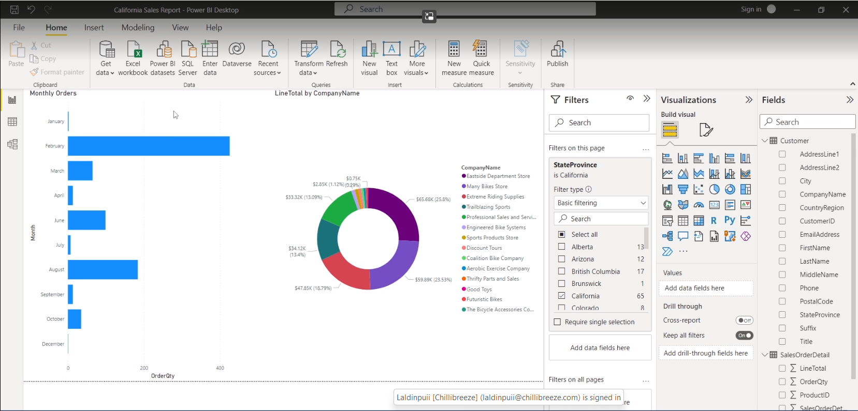
Using Power BI online requires a subscription.

Slide 93
Power BI Features
Exports PDF Format
Create Dashboards

Slide 94

Distribute Your Reports
Finalize your report
Export it for review
Share your report dashboard

Slide 95
Managing Data with Microsoft 365

Slide 96
In this course:
Forms
Power Automate
Excel
Power BI

Slide 97
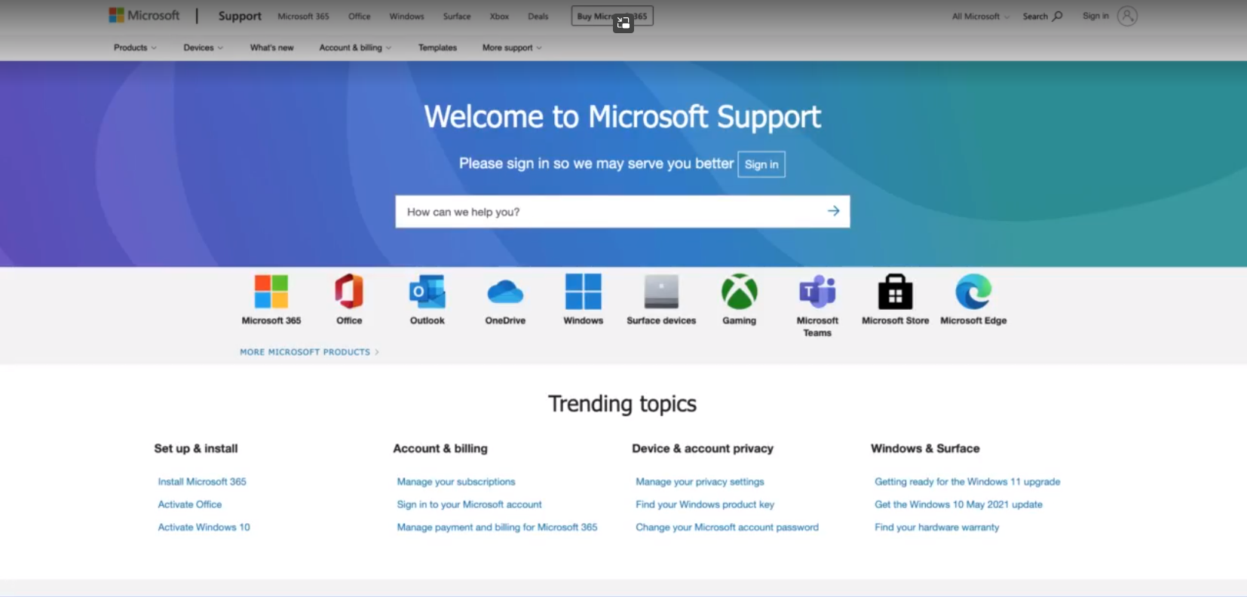
https://support.microsoft.com
https://support.microsoft.com/

Slide 98
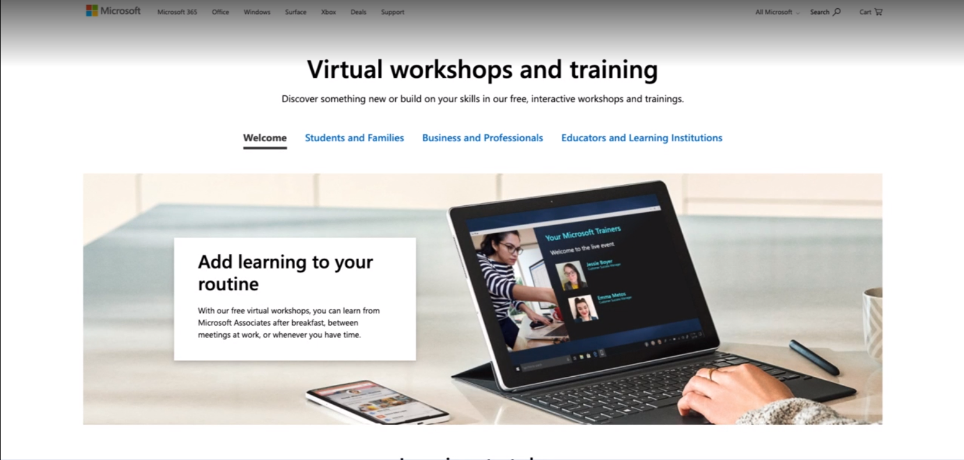
https://www.microsoft.com/en-us/store/workshops-training-and-events/

Slide 99
Managing Data with Microsoft 365

